Slide 1
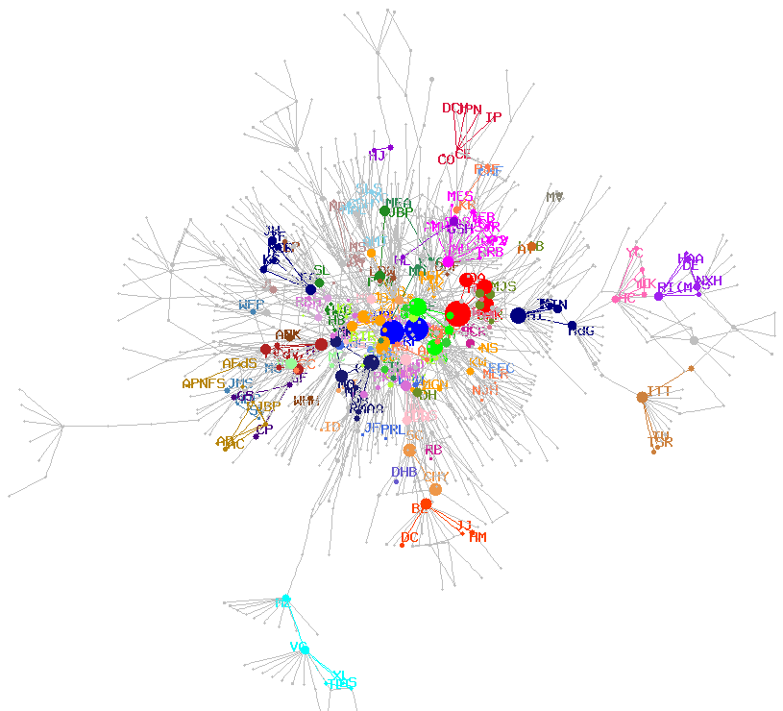
Advancements in Genetic Programming for Data Classification
Dr. Hajira Jabeen
Iqra University
Islamabad, Pakistan

Slide 2
Introduction

Slide 3
Genetic Programming
Solution representation
Random solution initialization
Fitness estimation
Reproduction operators
Termination condition
/
-
*
A2
A3
A1
A3
/
A2
+
A3
A5
/
-
*
A2
A3
A1
A3
/
-
*
A2
A3
A1
A3
/
A2
*
A3
A5
/
-
*
A3
A5
/
A1
A2
+
8.06
A6
/
-
+
A3
A3
A1
A5
/
A2
*
A2
A3
/
-
+
A4
A3
A1
0.3
Full Method
Grow Method
Crossover
Mutation

Slide 4
Classification using Genetic Programming
Advantages
Global search
Flexible
Data modeling
Feature extraction
Data distribution
Transparent
Comprehensible
Portability
Disadvantages
Long training time
Bloat (larger classifier size)
Lack of convergence
Mixed type data
Multiclass classification

Slide 5
DepthLimited Crossover

Slide 6
Classification using GP
/
-
*
A2
A3
A1
3.4
Solution Representation
Arithmetic classifier expression (ACE)
Function set = {+ , - , / , * }
Terminal set = {attributes of data, ephemeral constant}
Solution Initialization
Ramped half and half method
Maximum Depth
depth=ceil(log₂(A_{d}))
Where A_{d} is total number of attributes present in the data

Slide 7
Classification using GP
Fitness
Classification accuracy
Reproduction operators
Mutation
Point mutation
Reproduction
Copy operator
Crossover
DepthLimited Crossover

Slide 8
DepthLimited Crossover
*
/
/
-
+
-
A4
A2
A3
A1
A2
A5
A6
-
+
*
/
/
-
0.3
A3
A4
A2
A3
A2
-
*
A4
A2
A3
Invalid Crossover
Valid Crossover
Jabeen, H and Baig, A R., "DepthLimited Crossover in Genetic Programming for Classifier Evolution.“ Computers in Human Behaviour, Vol (27) 1, pp 1475-1481, Springer, 2010.

Slide 9
DepthLimited Crossover
Initial Depth Limits
Limit the search space
Liberal search limits
Depth must include all the attributes
The value of depth
d = ceil(log₂(A_{d}))
A full tree of depth ‘d’ can contain all attributes of data.

Slide 10
Complexity
Increase in average number of nodes in population using GP with no size limits
Increase in average number of nodes in population using DepthLimited GP

Slide 11
Optimization of GP Evolved Classifier

Slide 12
Optimization of Expressions
Motivation
Long training time
Lack of convergence
Reason
Classifier evaluated for each training instance
All evolutionary algorithms do not converge to same solution
Solution
Optimization

Slide 13
GP+PSO=GPSO
Start
GP for ACE evolution
Best GP ACE
Add weights to ACE
PSO to optimize weights
End
Best particle + ACE = GPSO
Jabeen, H and Baig, A. R., “GPSO: Optimization of Genetic Programming Classifier Expressions for Binary Classification using Particle Swarm Optimization.” International Journal of Innovative Computing, Information and Control, Vol (8) 1a, pp 223-242 2011.

Slide 14
GP+PSO=GPSO
Solution representation
= {W1, W2, W3}
Solution initialization
Fitness estimation
Position update
Termination condition

Slide 15
Wisconsin Breast Cancer Dataset

Slide 16
Classifiers for Pima Indian’s Dataset
GP | * + / A3 A1 * A2 A5 + - A3 A2 - A3 8 | 69.9%
GPSO | * + / * A3 0.50 * A1 0.58 * * A2 0.75 * A5 0.56 + - * A3 0.29 * A2 0.49 - * A3 0.62 * 8 -0.79 | 71.8%

Slide 17
Classification of Mixed-Type Attribute Data

Slide 18
Mixed Attribute Data
Motivation
Use combination of arithmetic expressions and logical rules
Reasons
Classifier expressions applicable to numerical data
Rules applicable to categorical data
Solutions
Convert categorical to enumerated value
Numerical values to categorical values
Use constrained syntax GP

Slide 19
Two Layered Classifier
Solution representation
AND
OR
T1
T2
NOT
T3
Outer Layer Tree
Arithmetic Inner Tree Probability
Logical Inner Tree Probability
OR
AND
C₁='a'
C₂='b'
OR
C₃='c'
C₁='d'
+
/
A₁
A₂
*
A₂
A₃
Arithmetic Inner Tree
Logical Inner Tree
Jabeen, H and Baig, A. R., “Two Layered Genetic Programming for Mixed Variable Data Classification.” Applied Soft Computing, Vol (12) 1, pp 416-422

Slide 20
Two Layered Classifier
Crossover Operator

Slide 21
Mutation
AND
OR
+
T3
A2
-
A3
3.2
NOT
T2
AND
OR
T1
T2
NOT
AND
C1=‘a’
C2=‘b’
AND
OR
*
T3
A8
/
A4
A3
NOT
T2
AND
OR
T1
T2
NOT
OR
C1=‘d’
C3=‘a’

Slide 22
Evolution of Best Trees

Slide 23
Multi-class Classification

Slide 24
Multi-class Classification
Motivation
Lack of a definitive solution for multiclass classification
Reasons
Binary classifier
Solutions
Binary decomposition
Thresholds

Slide 25
Multi-class Classification Approaches
A four class classification problem, C=4
Number of classifiers C in binary decomposition =‘4’
Number of classifiers N in binary encoding=ceil(log₂(4) )=‘2’
Number of conflicts in binary decomposition =12
Number of conflicts in binary encoding = 2^{N}-C=0

Slide 26
Binary Encoding for Classifier
Classification matrix for a 4 class problem
Binary Encoding
Binary Decomposition
 | Classifier 1 | Classifier 2
Class1 | 0 | 0
Class2 | 0 | 1
Class3 | 1 | 0
Class4 | 1 | 1
 | Classifier 1 | Classifier 2 | Classifier 3 | Classifier 4
Class1 | 1 | 0 | 0 | 0
Class2 | 0 | 1 | 0 | 0
Class3 | 0 | 0 | 1 | 0
Class4 | 0 | 0 | 0 | 1

Slide 27
Comparison
Datasets | Algorithms | BDGP | ENGP
IRIS | ACC | 96.00% | 97.20%
 | SD | 0.2 | 0.3
 | Conflicts | 5 | 1
 | Classifiers | 3 | 2
WINE | ACC | 78.50% | 90.10%
 | SD | 0.2 | 0.2
 | Conflicts | 5 | 1
 | Classifiers | 3 | 2
VEHICLE | ACC | 49.00% | 83.00%
 | SD | 0.3 | 0.2
 | Conflicts | 12 | 0
 | Classifiers | 4 | 2
GLASS | ACC | 54.70% | 76.70%
 | SD | 0.4 | 0.2
 | Conflicts | 122 | 2
 | Classifiers | 6 | 3
YEAST | ACC | 57.00% | 73.80%
 | SD | 0.6 | 0.1
 | Conflicts | 1014 | 24
 | Classifiers | 10 | 4
BDGP=Binary Decomposition
ENGP=Binary Encoding

Slide 28
Complexity and Convergence
Number of nodes and fitness (Average, Best) Wine
Number of nodes and fitness (Average, Best) Iris

Slide 29
Summary
Computational efficient
Less conflicts
Better accuracy

Slide 30
Conclusion
GP based classification
DepthLimited crossover
Optimization of classifiers
Mixed-type data classification
Efficient multi-class classification

